Slide 1

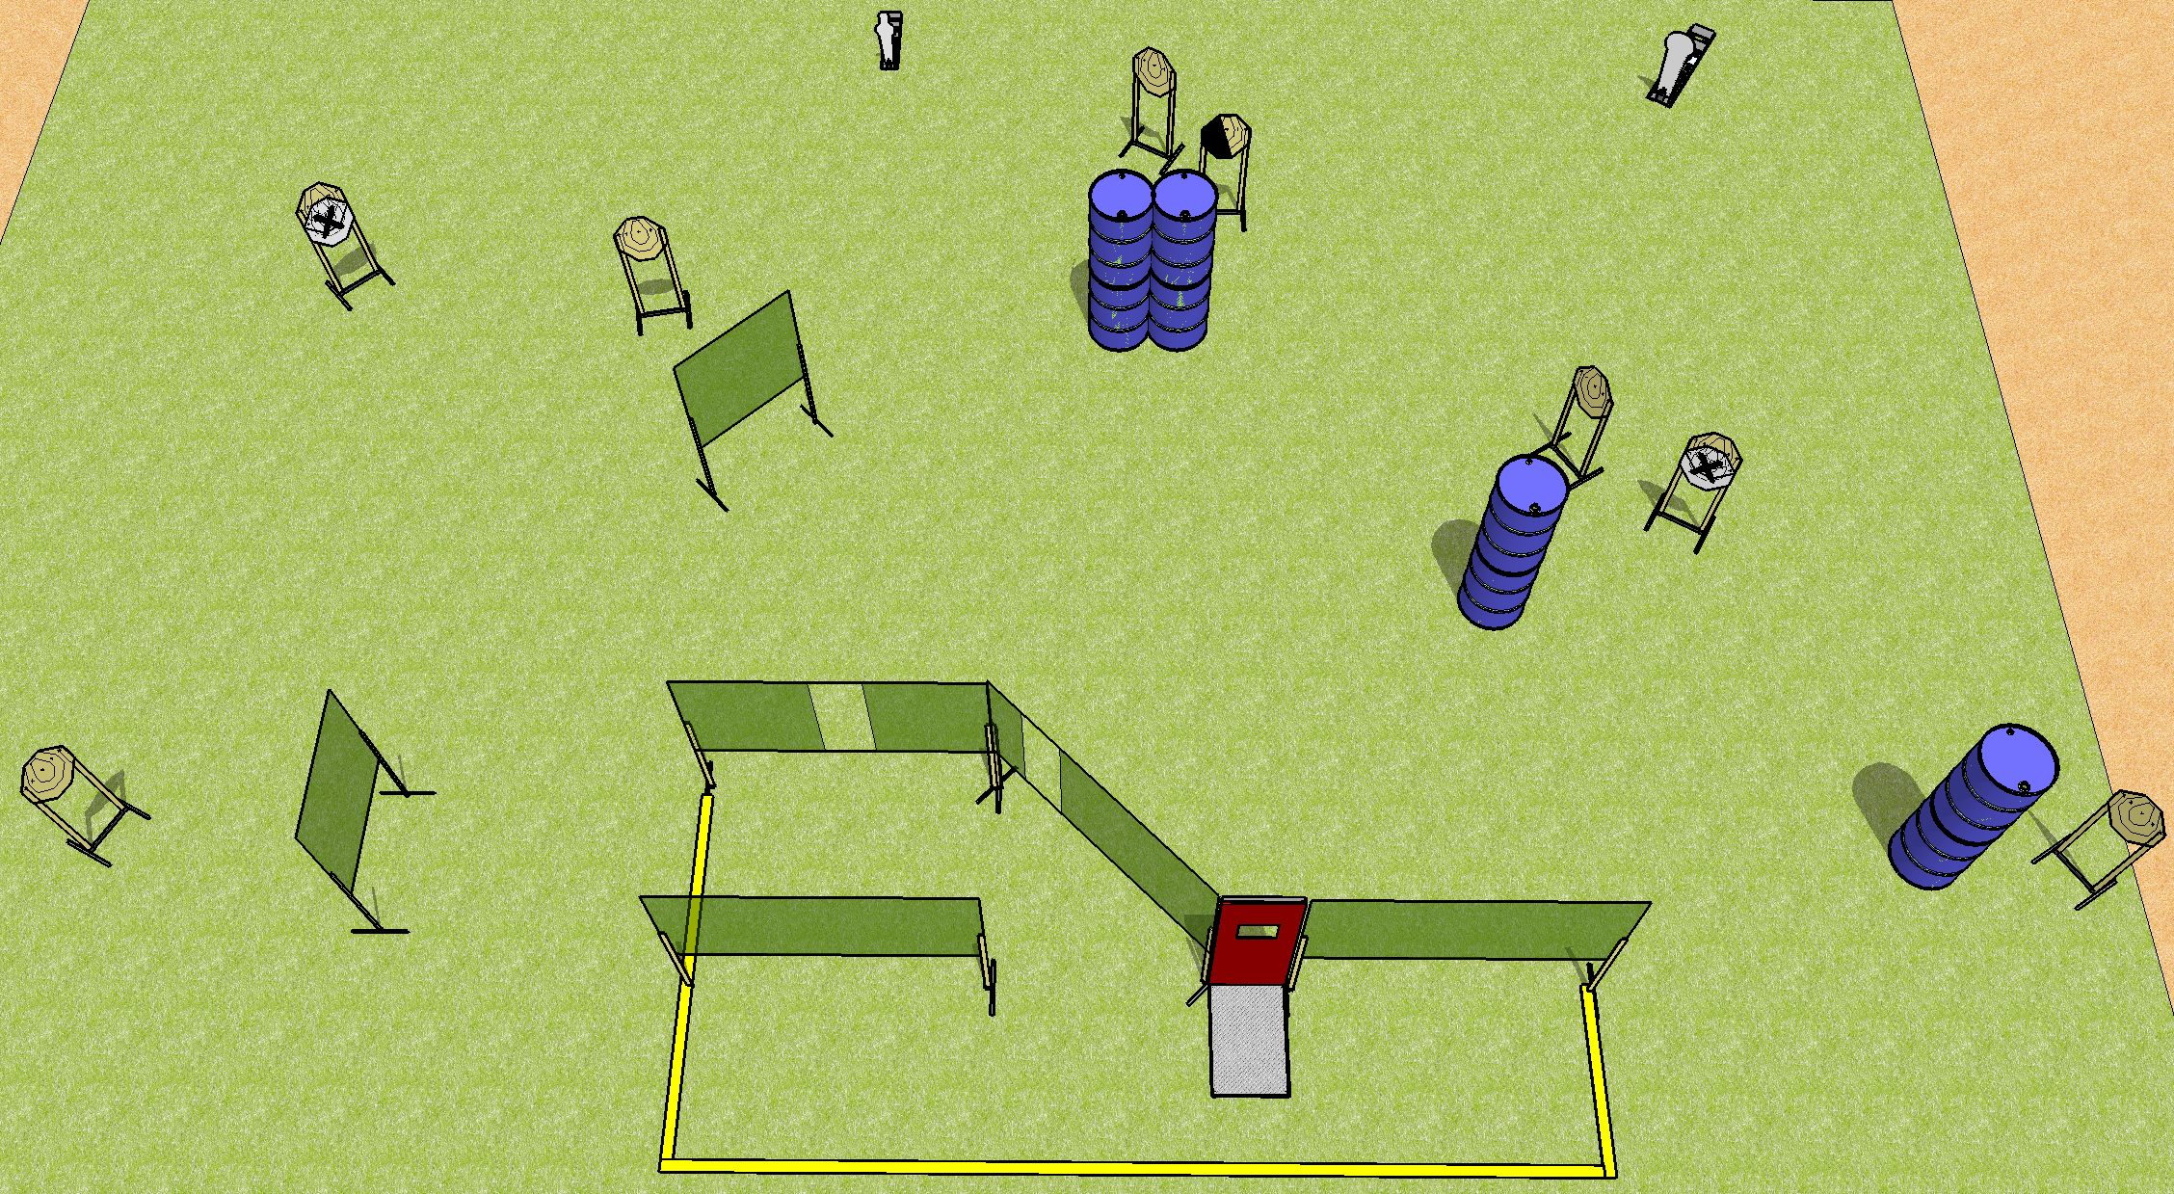
 | Dothan Practical Shooters – USPSA Match Handholding Course Designer : Drew Coleman Bay: B3
Round Count 18 rounds 8 IPSC 1 mini, 1 colt
Equipment List 12 wall feet Pull cord barricade 1 left diag 9 targets (7 + 2 NS)

Slide 2
Handholding
Written Stage Briefing
Scoring: Comstock Rounds: 18
Targets: 8 IPSC, 2 steel
Handgun start position: anywhere inside the shooting area, wrists above shoulders. Handgun is loaded and holstered.
PCC start position: anywhere inside the shooting area, wrists above shoulders. Loaded carbine is held with both hands, safety on.
Stage Procedure: on the audible start signal, engage targets as they become available from within the shooting area.

